Slide 1
Evaluating accuracy of a model using calculations

Slide 2
It's impractical to visually compare predicted and actual values across thousands of rows
y_test y_pred
Instead we use standard calculations to get a sense of overall accuracy
index | ACTUAL_ARR_DELAY
291483 | -5.0
164800 | 20.0
… | …
60706 | -6.0
PREDICTED_ ARR_DELAY
3.48
5.80
…
6.08

Slide 3
Mean Squared Error (MSE) is the average error
MSE = mean((actual – predicted)**2)
You could write a python function to loop through each row, and perform this calculation
OR You could use mean_squared_error from the scikit-learn library
from sklearn import metrics
metrics.mean_squared_error(y_test, y_pred)

Slide 4
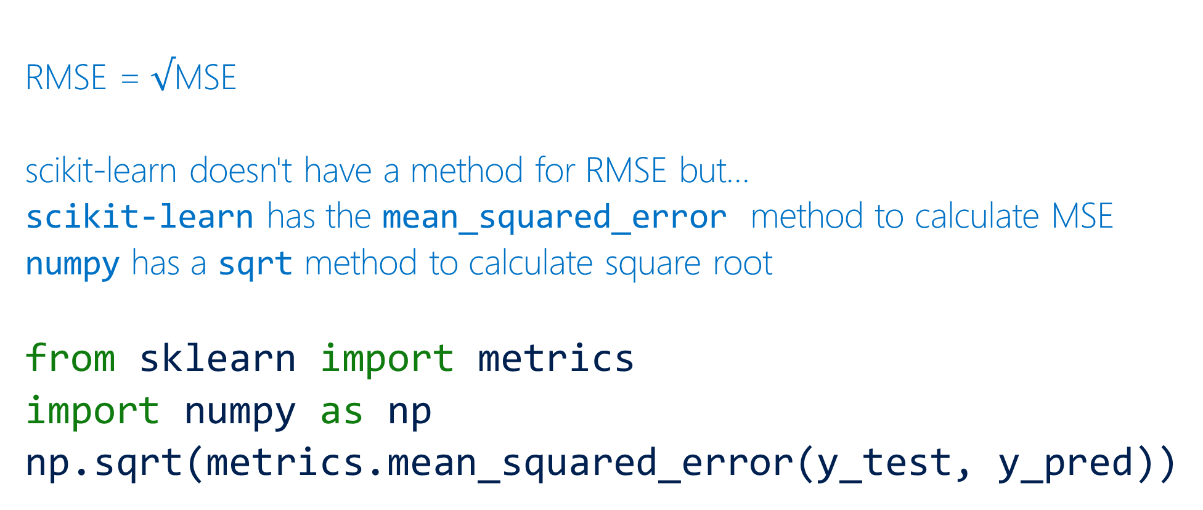
Root Mean Squared Error (RMSE) is the square root of the mean squared error
RMSE = $√$MSE
scikit-learn doesn't have a method for RMSE but…
scikit-learn has the mean_squared_error method to calculate MSE
numpy has a sqrt method to calculate square root
from sklearn import metrics
import numpy as np
np.sqrt(metrics.mean_squared_error(y_test, y_pred))

Slide 5
Different models have different metrics to measure accuracy numpy provides standard mathematical functions scikit-learn provides a number of functions for assessing prediction error Together they allow us to measure model accuracy

